Slide 1
Welcome!
Sunday
Bible Study 9:30 AM
Worship 10:30 AM
PM Bible Class (Livestream) 5:00 PM
Wednesday
Bible Class 7:00 PM
www.SunsetchurchofChrist.net

Slide 2
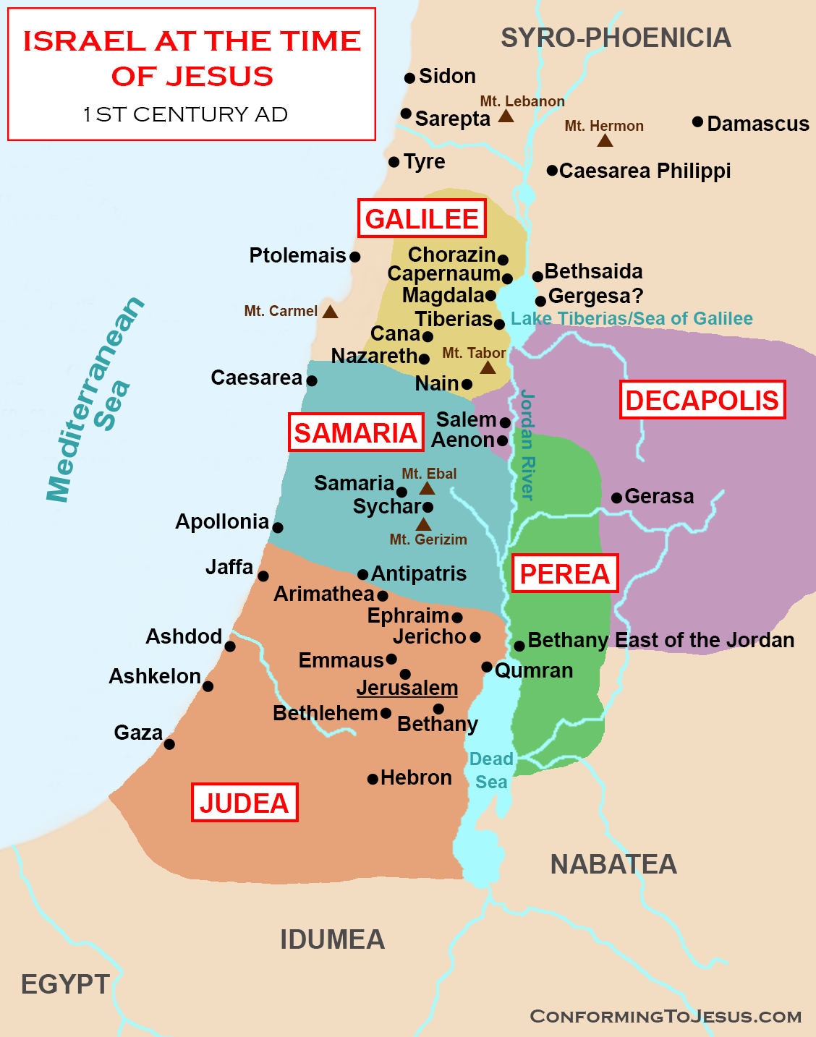
John 4
The Samaritans
Notes:
Map taken with permission from https://www.conformingtojesus.com/images/webpages/israel_at_the_time_of_jesus_christ_1.png
Terms https://www.conformingtojesus.com/terms-conditions.htm

Slide 3
John 4
History of the Samaritans
2 Kings 17:24-34
The king of Assyria brought people from Babylon, Cuthah, Ava, Hamath, and from Sepharvaim, and placed them in the cities of Samaria (vs 24)

Slide 4
John 4
History of the Samaritans
Darius III authorized a temple (c.370BC)
Built on Mt. Gerizim
Jews destroyed the temple (128BC)
Romans built a temple on the site (c.120 AD)

Slide 6
John 4

Slide 9
John 4:1-6
Departure from Judea
Passage through Samaria
Jacob’s well (Gen. 48:22)

Slide 10
Notes:
Map taken with permission from https://www.conformingtojesus.com/images/webpages/israel_at_the_time_of_jesus_christ_1.png
Terms https://www.conformingtojesus.com/terms-conditions.htm

Slide 13
John 4:7-14
The Samaritan Woman
The inquiry
The response
Why would a Jew ask a Samaritan
“Our father Jacob…..”
Jesus and the Living Water

Slide 14
Welcome!
Sunday
Bible Study 9:30 AM
Worship 10:30 AM
PM Bible Class (Livestream) 5:00 PM
Wednesday
Bible Class 7:00 PM
www.SunsetchurchofChrist.net

Slide 15
Opening Prayer | Anthony Ward
Song – 35 | Grant Haines
Scripture Reading | Michael Hetzer
Song – 636 | Grant Haines
Song – 175 | Grant Haines
Lord’s Supper | Michael Hetzer
Song – 350 | Grant Haines
Collection | Michael Hetzer
Song – 9 | Grant Haines
Lesson | Brian Haines
Song – 325 | Grant Haines
Closing | Ryan Sollars

Slide 16
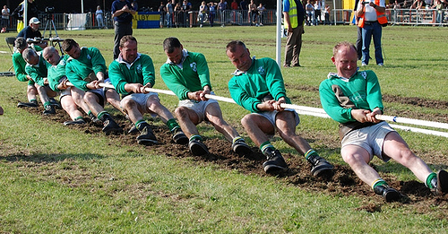
Tug of War
Each person pulling their hardest
The need to be anchored
The danger of slipping
Notes:
During the Tang dynasty, Emperor Xuanzong of Tang promoted large-scale tug of war games, using ropes of up to 548 ft with shorter ropes attached, and more than 500 people on each end of the rope
Tug of war games in ancient Greece were among the most popular games used for strength and would help build strength needed for battle in full armor.
The Mohave people occasionally used tug-of-war matches as means of settling disputes.
Tug of War removed after 1920 Olympics

Slide 17
Struggles of the Local Church

Slide 18
A Church in Smyrna
Revelation 2:8-11
“I know your works”
“(I know your) tribulation”
“(I know your) poverty”
Notes:
Re 2:8 ¶ "And to the angel of the church in Smyrna write, 'These things says the First and the Last, who was dead, and came to life: 9 "I know your works, tribulation, and poverty (but you are rich); and I know the blasphemy of those who say they are Jews and are not, but are a synagogue of Satan. 10 "Do not fear any of those things which you are about to suffer. Indeed, the devil is about to throw some of you into prison, that you may be tested, and you will have tribulation ten days. Be faithful until death, and I will give you the crown of life. 11 "He who has an ear, let him hear what the Spirit says to the churches. He who overcomes shall not be hurt by the second death."'

Slide 19
A Church in Smyrna
Revelation 2:8-11
Jesus promised:
They need not fear their suffering
To reward faithful service
Notes:
Re 2:8 ¶ "And to the angel of the church in Smyrna write, 'These things says the First and the Last, who was dead, and came to life: 9 "I know your works, tribulation, and poverty (but you are rich); and I know the blasphemy of those who say they are Jews and are not, but are a synagogue of Satan. 10 "Do not fear any of those things which you are about to suffer. Indeed, the devil is about to throw some of you into prison, that you may be tested, and you will have tribulation ten days. Be faithful until death, and I will give you the crown of life. 11 "He who has an ear, let him hear what the Spirit says to the churches. He who overcomes shall not be hurt by the second death."'

Slide 20
A Church in Philadelphia
Revelation 3:7-12
“I know your works”
“You have kept my command to persevere”
Notes:
Re 3:7 ¶ "And to the angel of the church in Philadelphia write, 'These things says He who is holy, He who is true, "He who has the key of David, He who opens and no one shuts, and shuts and no one opens": 8 "I know your works. See, I have set before you an open door, and no one can shut it; for you have a little strength, have kept My word, and have not denied My name. 9 "Indeed I will make those of the synagogue of Satan, who say they are Jews and are not, but lie--indeed I will make them come and worship before your feet, and to know that I have loved you. 10 "Because you have kept My command to persevere, I also will keep you from the hour of trial which shall come upon the whole world, to test those who dwell on the earth. 11 "Behold, I am coming quickly! Hold fast what you have, that no one may take your crown. 12 "He who overcomes, I will make him a pillar in the temple of My God, and he shall go out no more. And I will write on him the name of My God and the name of the city of My God, the New Jerusalem, which comes down out of heaven from My God. And I will write on him My new name.

Slide 21
A Church in Philadelphia
Revelation 3:7-12
Jesus promised:
To set an open door
To make enemies submit
To reward faithful service
Notes:
Re 3:7 ¶ "And to the angel of the church in Philadelphia write, 'These things says He who is holy, He who is true, "He who has the key of David, He who opens and no one shuts, and shuts and no one opens": 8 "I know your works. See, I have set before you an open door, and no one can shut it; for you have a little strength, have kept My word, and have not denied My name. 9 "Indeed I will make those of the synagogue of Satan, who say they are Jews and are not, but lie--indeed I will make them come and worship before your feet, and to know that I have loved you. 10 "Because you have kept My command to persevere, I also will keep you from the hour of trial which shall come upon the whole world, to test those who dwell on the earth. 11 "Behold, I am coming quickly! Hold fast what you have, that no one may take your crown. 12 "He who overcomes, I will make him a pillar in the temple of My God, and he shall go out no more. And I will write on him the name of My God and the name of the city of My God, the New Jerusalem, which comes down out of heaven from My God. And I will write on him My new name.

Slide 22
Each Part Doing Its Part
Ephesians 4:11-16
Works within the church
Equipping saints to service
Perfecting the local church
To create more workers

Slide 23
What You Need to Know
A church succeeds by each member pulling
What is your role?
Are you encouraging others?
Notes:
1Co 9:25 And everyone who competes for the prize is temperate in all things. Now they do it to obtain a perishable crown, but we for an imperishable crown. 26 Therefore I run thus: not with uncertainty. Thus I fight: not as one who beats the air. 27 But I discipline my body and bring it into subjection, lest, when I have preached to others, I myself should become disqualified.
1Co 12:28 And God has appointed these in the church: first apostles, second prophets, third teachers, after that miracles, then gifts of healings, helps, administrations, varieties of tongues. 29 Are all apostles? Are all prophets? Are all teachers? Are all workers of miracles? 30 Do all have gifts of healings? Do all speak with tongues? Do all interpret?

Slide 24
What You Need to Know
A church succeeds by each member pulling
A member succeeds by being anchored
Unanchored members are not pulling
Notes:
Heb 6:19 This hope we have as an anchor of the soul, both sure and steadfast, and which enters the Presence behind the veil, Heb 6:19 This hope we have as an anchor of the soul, both sure and steadfast, and which enters the Presence behind the veil,

Slide 25
What You Need to Know
A church succeeds by each member pulling
A member succeeds by being anchored
Know the dangers of slipping
The things that cause us to fall
The impact it has on others
Notes:
Heb 6:19 This hope we have as an anchor of the soul, both sure and steadfast, and which enters the Presence behind the veil, Heb 6:19 This hope we have as an anchor of the soul, both sure and steadfast, and which enters the Presence behind the veil,

Slide 26
What You Need to Know
As a congregation:
We have fewer members
We are Scripturally unorganized
Are you rising to that challenge?
We need more serving
We need stronger support
Notes:
Heb 6:19 This hope we have as an anchor of the soul, both sure and steadfast, and which enters the Presence behind the veil, Heb 6:19 This hope we have as an anchor of the soul, both sure and steadfast, and which enters the Presence behind the veil,

